Slide 1

1
FAQ CHATBOT WEB FRAMEWORK FOR COMPARISONS AND PERFORMANCE ANALYSIS
Chatbot Image adapted from https://www.singlegrain.com/email-marketing/email-marketing-vs-chatbot-marketing-the-ultimate-showdown/
Presented By: Russell Chua Kui Hon
Supervisor: Associate Professor Chng Eng Siong
Examiner: Dr Smitha Kavallur Pisharath Gopi
Notes:
A very good day to Professor Chng and Dr Smitha I will be presenting to you my final year project. An FAQ Chatbot for comparisons and performance analysis. This Project is a full stack web development project developed with consideration of software development techniques and system architecture implementations.

Slide 2



OUTLINE
2
INTRODUCTION
CHATBOT SERVICES
FRAMEWORK IMPLEMENTATION
DATA PRE-PROCESSING
FEATURES
CONTRIBUTIONS
FUTURE IMPLEMENTATIONS
Notes:
Before i proceed with my project description, i would like to bring you through an outline of my presentation.
Starting with the introduction I will be covering a brief background of my project, motivations and a quick look at the final product features
Chatbot Services will go through Chatbot APIs that are currently integrated into the application.
Framework implementation will cover the overall infrastructure of my application and a discussion of my choice of software
Data pre-processing will cover the data construction for Chatbot training for non proprietary services.
Features will cover the current running features that the application has
Finally concluding with a short demo, overall contributions and my recommendations for the future development of project

Slide 3

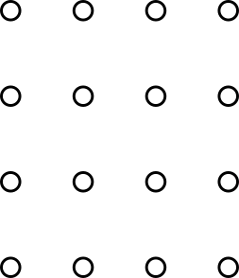
INTRODUCTION
3
Motivation
To build a full stack web application that can support all types of Chat bot services
Simulate various chat bot applications use cases
Response Accuracy Comparisons
Visual Assessment of Chatbot performance
Notes:
The motivation of this project is to essentially built a fully functional and production grade web application fully capable of supporting various kinds of Chatbot services
Besides that we will want to be able to emulate various kinds of chatbot input cases this can range from the basic text input to more advanced input methods like a real time speech input
Developing a platform for Chatbot developers to analyse their chatbot performance against a benchmark chatbot model
And hopefully be able to deliver a virtual overview of the chatbot performance

Slide 4


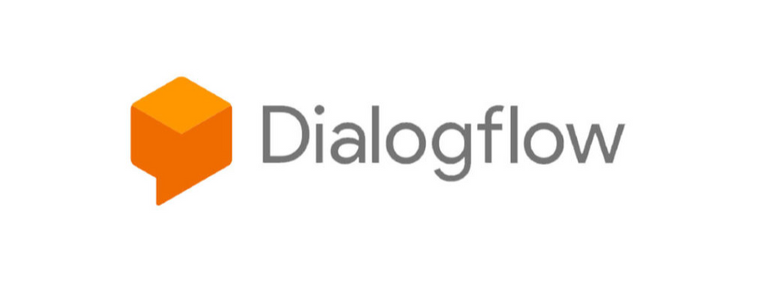
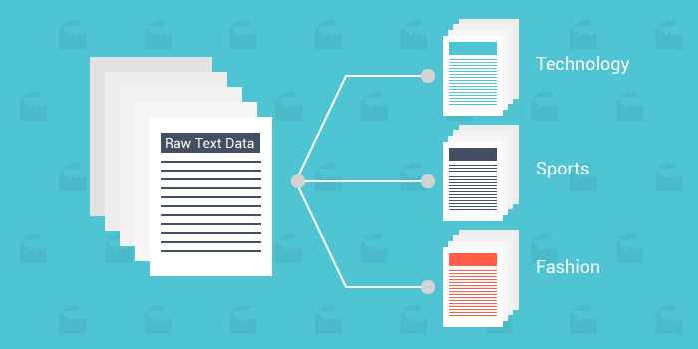
INTRODUCTION
4
Ask Jamie Banner adapted from
https://www.profamilyleave.gov.sg/Pages/Virtual-Assistant.aspx
Ask Jamie
Virtual assistant developed by Gov tech agency
Implemented across 70 government agency websites
Used as a Benchmark model for other Chatbot services
Nanyang Technological University Banner adapted from
https://www.ntu.edu.sg/
Dialogflow Logo adapted from
https://dialogflow.com/
Text Classification Model adapted from
https://medium.com/@bedigunjit/simple-guide-to-text-classification-nlp-using-svm-and-naive-bayes-with-python-421db3a72d34
Notes:
For response assessment to be possible, there is a need for a benchmark we can follow
The Chatbot benchmark used for this framework comparison would be a Government Developed Virtual assistant Ask Jamie. Ask Jamie virtual assistant, developed by the Govtech agency is being implemented across 70 government agencies and serving FAQ queries of various context.
All chatbot services integrated to this framework will essentially be making comparisons with Ask Jamie chatbot.

Slide 5
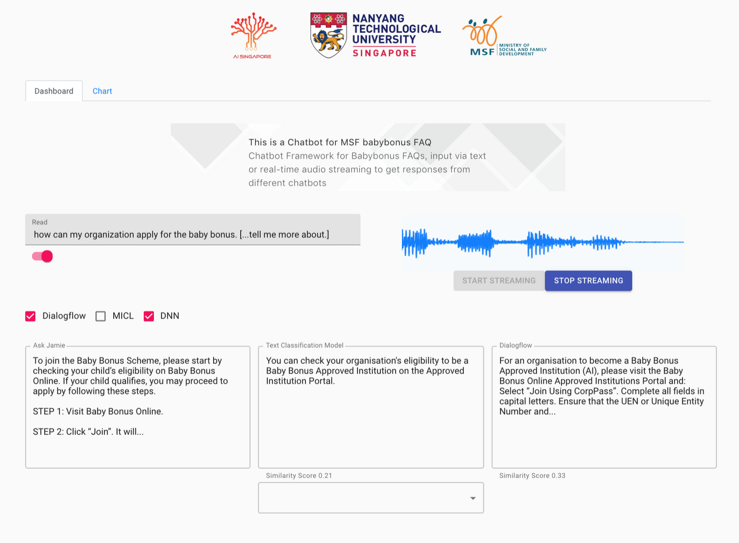
INTRODUCTION
5
Input and Speech Solution
Modular Chatbot Service
Response Comparison
Notes:
With the motivations set, the objectives required to realize this project is to be able to build a modular platform for seamless onboarding of chatbot services.
To tackle user experience, an all rounded input solution will be provided in the form of real time speech and text to facilitate various forms of interactions
To help chatbot engineers assess the reliability of their chatbots, an accuracy assessment will be implemented to be able to understand where their bot stands against a reliable benchmark model

Slide 6
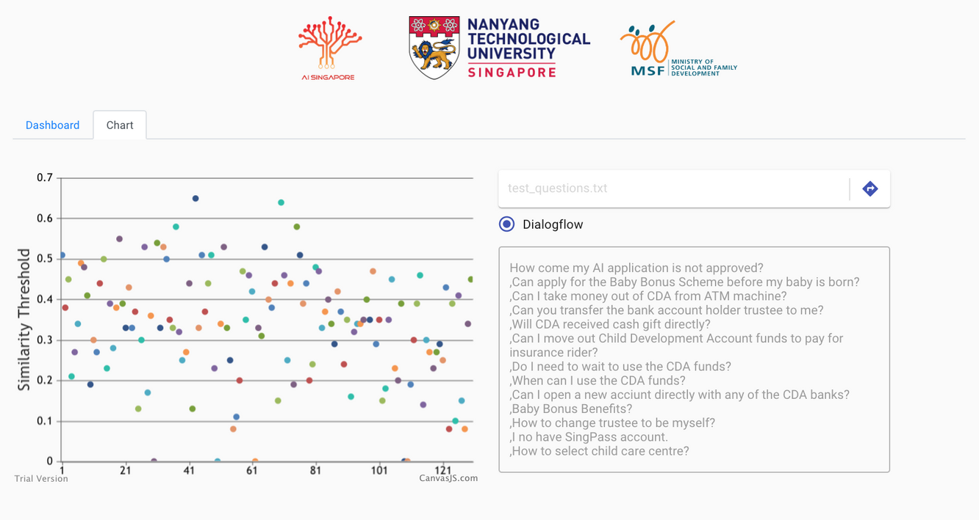
INTRODUCTION
6
Batch Intent Upload
Chatbot Performance Visualization
Notes:
More advanced approach to this framework is to be able to give users an option to load larger batches of input into the framework for a graphical overview of accuracy performance, hopefully this would help developers better gauge their standing of their chatbot against production level chatbots

Slide 7




INTRODUCTION
7
External API
Chatbot Framework
Ask Jamie API
MICL QA API
Input
REST API
Text Classification API
View Component
Presentation Layer
Backend
Server
Dialogflow API
Notes:
The web framework consist a client view and a backend to readily facilitate active connections to the various chatbot services, as well as to handle multiple input connections from users. Hence to ensure app resilience and scalability, research is done to understand the tools and software utilized to make this framework possible.

Slide 8
8
PROVIDED MODELS
ASK JAMIE
MICL LABS QA MODEL
CHATBOT
SERVICES
SELF-TRAINED MODELS
DIALOGFLOW
TEXT CLASSIFICATION MODEL
Notes:
For this Chatbot framework, I will be introducing 4 primary chatbot service to for testing in this project development environment. 2 provided models are ask Jamie and MICL labs QA model and another 2 self trained models Dialogflow and text classification models are proof of concepts services to show the variety of chatbots that can be integrated to this framework

Slide 9


CHATBOT SERVICES
9
Chatbot Context
Ministry of social and family development's Baby Bonus
Wider age group user base and varied English competency
MSF Banner adapted from https://www.msf.gov.sg/
Ask Jamie Banner adapted from https://www.babybonus.msf.gov.sg/
Notes:
For the context of this project development, we will be focused on FAQ chat services a more basic direct question answer matching approach. The FAQ topic we will be targeting on is the Ministry of social and family development (MSF) Baby Bonus.
Baby Bonus covers a wide range of FAQ queries ranging from account setups, to schemes and application enquiries. It is also a very good test of question and answering matching models as baby bonus serves people of a wide age group and English competency levels. Hence making this context a great platform to test chatbot services responses to different ways of user input formal and informal.

Slide 10
CHATBOT SERVICES
10
MICL QA Matching
QA matching model designed by graduate student
Leveraging advanced Natural Language Processing model for QA matching
Contacted through API service hosted in MICL Lab
Notes:
Since the ask Jamie model has been discussed in the previous few slides, I will be talking about the other chatbot services in this framework
One provided model is a Question Answer Matching model developed by a NTU graduate student leveraging on powerful natural language processing models, this service is hosted on the cloud and contacted trhough API calls.

Slide 11
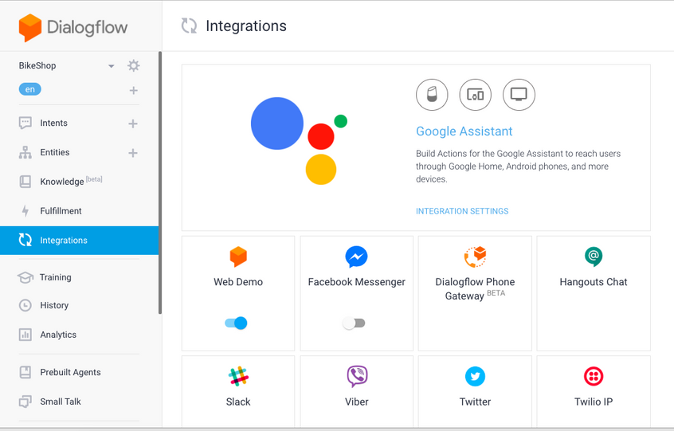
CHATBOT SERVICES
11
Dialogflow
Open source natural language processing platform developed by Google
Client interface to build conversational applications
Client API for intention uploading
Dialogflow Interface Screenshot adapted from
https://dialogflow.com/
Notes:
The first self-trained model used is the Dialogflow platform. Dialogflow is an open source a Natural language processing platform used for fast build up chatbot applications. Dialogflow strength lies in intuitiveness and fantastic user interface, allowing non-technical users to spin up a chatbot instance very quickly.
Dialogflow also provides an automated intent training solution where users can simply load up training phrases to train their own chatbot within seconds. And even make use of keywords to perform contextual mappings of a suitable intention.
Dialogflow also provides a client API, this means that developers are able to leverage on the client API to create more sophisticated chatbot, or train many more intentions.

Slide 12
CHATBOT SERVICES
12
Text Classification Model
Question prediction platform written in python
Trains permutations of questions and builds a model to predict question given different inputs
Notes:
The next self-trained model used is a text classification model. This model is written in python and used a proof of concept of designing a python architecture that can properly serve as a API service for future Chatbot models.

Slide 13

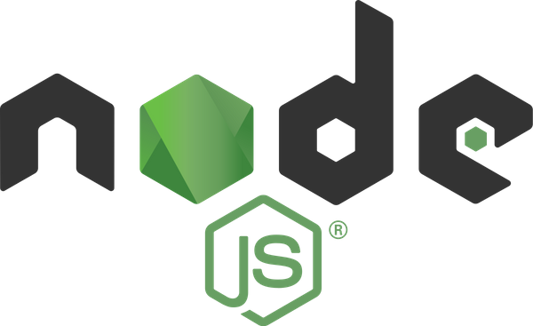


13
React Logo adapted from
https://reactjs.org/
CHATBOT FRAMEWORK
IMPLEMENTATION
Node Logo adapted from
https://nodejs.org/
Express Logo adapted from
https://expressjs.com/
Flask Logo adapted from
https://flask.palletsprojects.com/
Notes:
This section I will be going through the sub frameworks that is used in the development of this application. This application stack consist of React as the acting view of the application, Node and Express JS convering the back end implementation and Flask a web framework used as an API endpoint for response comparisons.
In the next few slides we will take a look at each framework and their capabilities in achieving the objective of this project.

Slide 14






FRAMEWORK IMPLEMENTATION
14
External Chatbot API
Application View Layer
Backend App Server
API Response (Answer)
Text Input
API Call (Question)
API Routing Layer
Data Layer (Controller)
MICL LABS
MICROFT
AZURE SERVER
Dialogflow
Route
MICL
Route
Dialogflow
Controller
MICL
Controller
Transcription
Speech Input
API Call
(Response Pair)
Comparison
Route
Ask Jamie
Route
Flask.
Controller
Ask Jamie
Controller
Chatbot Responses
Text Classifier
Route
Speech Transcription
Controller
Web Socket Connection
Live
Audio
Transcription
Speech Recognition API
Speech Live Transcription API
Web Socket Connection
Flask API Service
API Route Handler
Python Library Initialized on Start up
Text Classifier Model
Text Classifier Route
Cosine Similarity Comparison
Comparison Route
Notes:
The system architecture of the framework is made of 3 main components, Application view layer, Back end app server and a flask api service.
The flow of this architecture starts with the client application. In the diagram this is known as the application view layer. The view layer is developed on the React Framework, The view layer will provide the entry point for a chatbot interaction and a receiving point for viewing the chatbot response.
Input has 2 functions, text and speech, unlike a text input which offers a single request, speech input is real-time hence requiring active audio transcriptions which will be explain in the later slides. Speech input will require persistent connection to a transcription server provided by AISG's audio speech recognition api. Before transcribed text is sent as a text input from the view layer.
On question input, an API call will be established and the question is passed to the backend application server served by Node JS. Node JS server holds 2 layers, a routing layer and the data layer. The routing layer is written on Express JS, which is responsible for handling routing and forwarding of data to selected chatbot services, once a route is identified the data will be forwarded to the data layer this is the controller unit of server which is responsible for contacting the respective chatbot services.
The API response received from controller will be returned to chatbot response in the application view layer.
The responses are then sent again to the server calling the comparison route and forwarded to the Flask controller which contacts the Flask service API where response comparison is made and an similarity value is computed and returned to the view layer once again. Completing the flow of the application.

Slide 15
FRAMEWORK IMPLEMENTATION
15
React JS Front End
Application View
Anchor of the stack
Provides the overall view for the application
Chosen for Virtual Document Object Model
State
Component 1 [DOM]
Component 2 [DOM]
Notes:
Begining with the view component, React JS is responsible for fronting the overall view of the chatbot framework. React is decoupled and performs best when working with components. Each components consist of its own document object model allowing independent execution of functions and methods. Hence distributing workload across different features rather than the main view component.
Furthermore, React makes use of a virtual dom which changes the way typical site rendering works

Slide 16
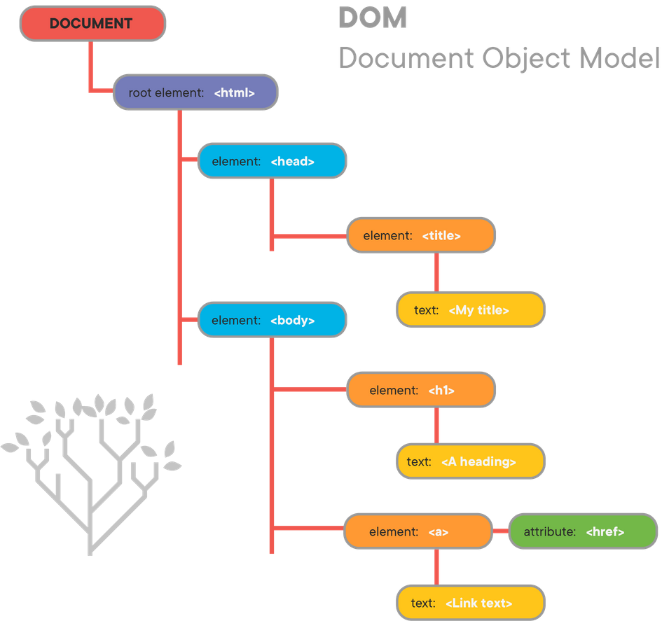
FRAMEWORK IMPLEMENTATION
16
Document Object Model
Tree Data structure for fast and efficient manipulation
Allows for dynamic page updates without web page refresh
Heavy pages requires constant updating of nodes
DOM tree structure adapted from
https://learn.co/lessons/fewpjs-the-dom-tree
Notes:
Like HTML or XML, Document Object Model plays a vital role in ensuring fast rendering and updating of view elements. That is because the DOM is build as a tree data struture allowing for fast and efficient manipulations. However, considering a feature heavy application, the DOM will not be able to perform as well as all nodes has to be updated constantly.

Slide 17
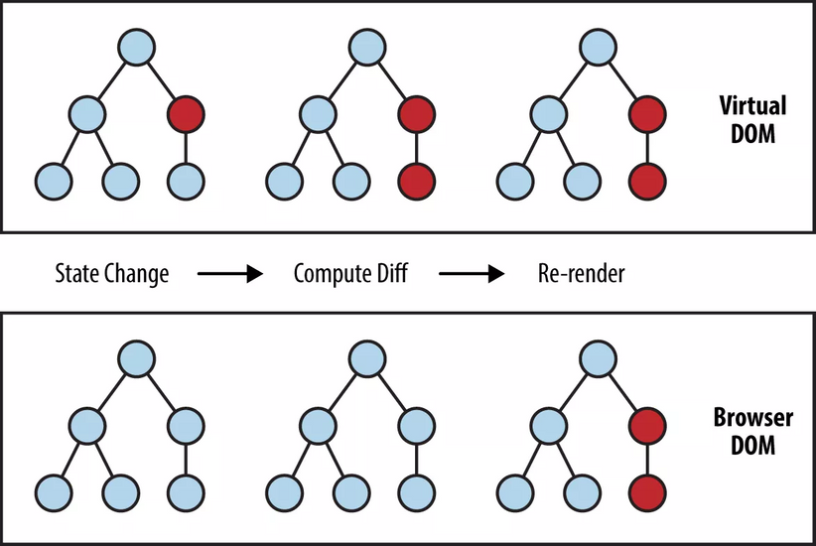
FRAMEWORK IMPLEMENTATION
17
React Virtual DOM
Virtual copy of the DOM structure
New Virtual DOM will be created on every update
Node differences will be computed and only affected nodes will be updated on DOM
Virtual DOM vs DOM adapted from
https://programmingwithmosh.com/react/react-virtual-dom-explained/
Notes:
This is where React comes in, in additon to the existing DOM, React makes use of a virtual DOM. A virtual DOM is essentially a virtual copy of the existing DOM just that it will be created on every element update. Element changes among the virtual dom will be computed and only the affected node will be changed in the actual dom. This would essentially prevent constant updates on heavy applications and provide a smoother experience for the users.

Slide 18

FRAMEWORK IMPLEMENTATION
18
Node JS Back End
JavaScript Engine
Light-weight, event driven model to handle data intensive requests
Capable of providing persistent and real time data streaming
Highly Scalable
Node JS Binding
Event Queue
Blocking Operation
Event loop
Achieve Asynchronous Communication
Notes:
The backend component is served by the Node JS framework, Node JS is a platform built on JavaScript runtime environment for easily building of fast and scalable network applications. Node JS is selected due to its light weight and event driven model and it is capable of providing real time data streaming with the build in web socket libraries.
Additionally, Node JS is highly scalable by providing making use of orchestration libraries for automated scaling.

Slide 19
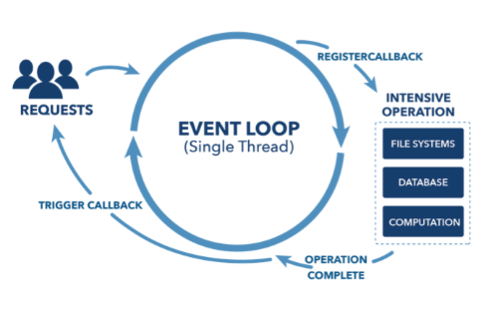
FRAMEWORK IMPLEMENTATION
19
Node Asynchronous Model
Single threaded and event driven
Efficient concurrency management of requests
Event loops to simulate non-blocking events eliminating use of threads
Event Loop adapted from
https://webapplog.com/event-loop/
Notes:
Node JS is build on a single threaded engine hence the only way it can use multi threaded properties are through event loops and callbacks. Each event contacts an I/O operation and while working, the next event will enter. This way the event loop will create a non-blocking operation where the events can be switched effectively to complete tasks efficiently. This eliminates the need of multi threading and further stress to the back end system.

Slide 20
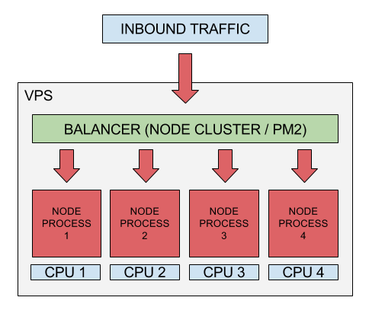
FRAMEWORK IMPLEMENTATION
20
Performance and Scalability
Horizontal Scaling
Internal load balancing for parallel processing on the same machine
Scalability Practices adapted from
https://medium.com/iquii/good-practices-for-high-performance-and-scalable-node-js-applications-part-1-3-bb06b6204197
Notes:
Node JS is also capable of scalability by offering a internal load balancing solution. This allows the node backend to scale horizontally, eliminating possibilities of requests bottlenecks
Wth this benefits provided by node, it is an essential system required to back the heavy requests from the client system

Slide 21
FRAMEWORK IMPLEMENTATION
21
REQUEST
Express JS Middle-ware
Minimal Node JS web application framework
Light-weight REST API middle-ware to handle data intensive requests
Route management for HTTP requests
API ENDPOINT
ROUTE 1
ROUTE 2
ROUTE 3
Notes:
Express JS in this framework acts as an API routing layer for the Node server. It is responsible for providing REST API middleware service to be able to securely route HTTP requests from client. Express will act as the bridge to all chatbot services and comparison APIs.

Slide 22
FRAMEWORK IMPLEMENTATION
22
Flask Micro Framework
API REQUEST
Python web application framework
Leverage Python Natural language processing libraries
Responsible for response comparator service written in Python
API ENDPOINT
RESPONSE
COMPARATOR
QA
MODELS
PYTHON LIBRARIES
Notes:
The final framework implemented would be the flask framework. The flask framework is a Python web application framework essentially to leverage python libraries to built powerful web applications.
For the purpose of this project Flask will server as an API server just like Node JS, but its only responsibility is to provide response comparison services for the client as an API call. Leveraging python's natural language processing models flask can host API calls for NLP services and even QA matching models.

Slide 23
23
SELF-TRAINED MODELS
DATA
PRE-PROCESSING
DIALOGFLOW
TEXT CLASSIFICATION MODEL
Notes:
The next few slides will give a brief walkthrough of Data pre-processing steps that are used in data preparation and training of 2 selftrained chatbot models integrated to this framework.

Slide 24
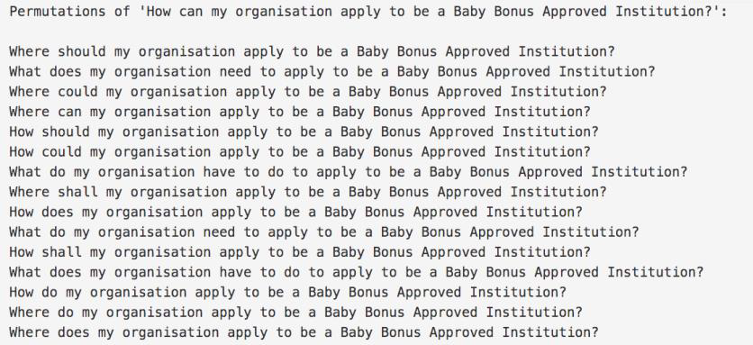
DATA PRE-PROCESSING
24
FAQ Input Permutations
Input Permutation of 300 baby bonus FAQ model questions
Each model question consist of thousands of possible permutations
Notes:
2 Data sets are provided for the purpose for pre-processing and training. The first data set consist of 300 baby bonus FAQ input and their respective permutations. These permutations are just different ways an intention can be phrased. Each intent consist of thousands of permutations hence the need for thorough processing.

Slide 25
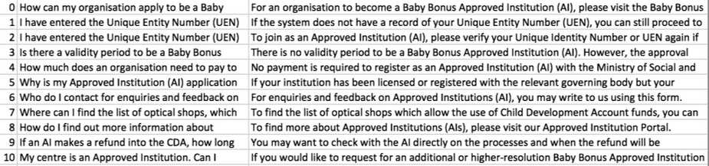
DATA PRE-PROCESSING
25
Model Question Answer
Model question and answer pairs obtained from Baby bonus
Used for direct retrieval of responses given identified intentions
Notes:
The 2nd data set are model intent and response pairs. This data set will be used for response matching for the identified intent by the self-trained models

Slide 26

DATA PRE-PROCESSING
26
Model QA
Intent Permutation
{
Intent: Model Question,
Pattern: [Permutation,..],
Response: Model Answer
}
Notes:
The objective of this pre-processing step is to be able to join the 2 data sets and properly use them for training of any QA models or online chatbot platforms. This can be done by extracting a permutations and mapping of permutations to the model answer pairs, this data object is parsed as a json entity for easy manipulation.

Slide 27

DATA PRE-PROCESSING
27
Client
Training of Dialogflow
Batch of intent data object
Success
Usage of Dialogflow API for intent uploading
Batch uploading of intent object due to request restrictions
Notes:
This data object constructed from the pre-processing steps are easily utilized in the batch upload and training of the Dialogflow platform. This can be applied to various chatbot platforms as well that provides a client API.

Slide 28
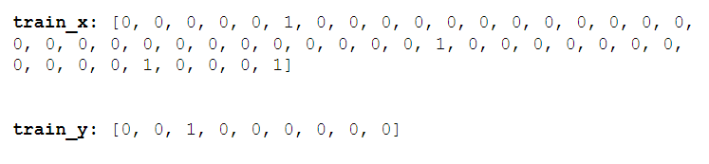
DATA PRE-PROCESSING
28
Training of Text Classification Model
Input 1
Tokenization of permutations
Unionization of unique tokenized words
Bag of words vectors developed for each permutation
Permutations
Input 1
Model
Input 2
Input 2
Permutations
Notes:
The last self trained model is an experimental text classification model used for the testing of the effectiveness of models on the flask framework.
The text classification model involves the tokenization of permutations, the tokenized words would then be appended into a list of unique words to be used for the construction of a bag of words for each permutations.
The bag of words will then be used in the training of the text classification model.

Slide 29
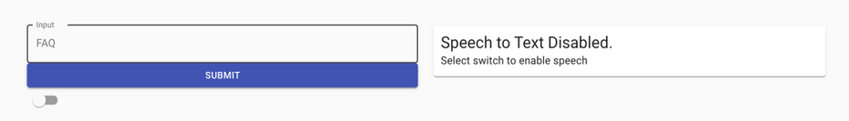
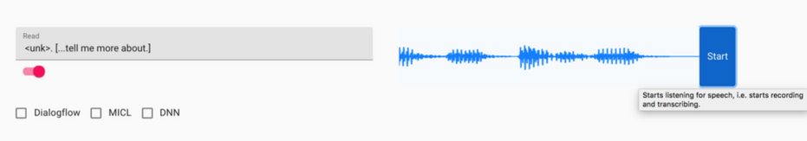
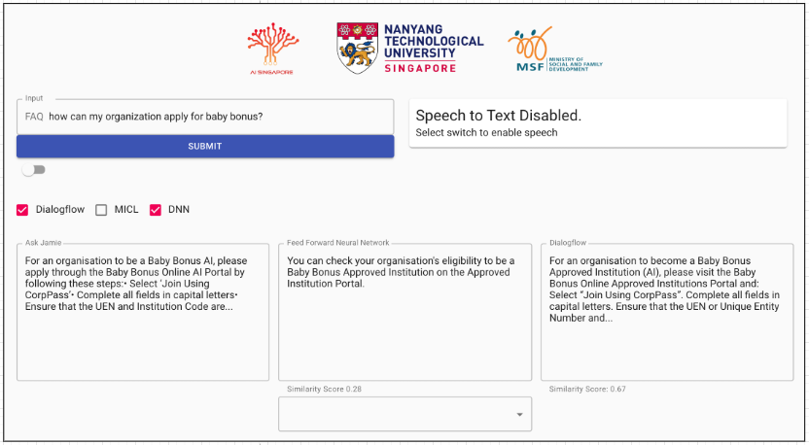
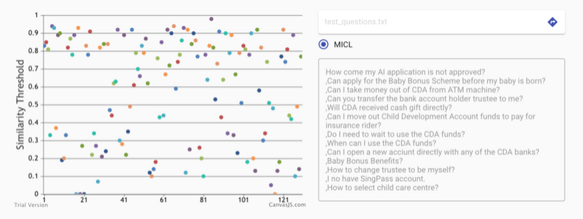
29
TEXT
INPUT
SPEECH
INPUT
FEATURES
RESPONSE
COMPARISON
PERFORMANCE ANALYSIS
Notes:
The final section of this presentation, I will be discussing the major features that have been implemented in the framework.
The first feature is most fundamental feature of a chatbot framework, a text input used for basic interaction entry point for users.
The second feature is another more advanced real-time speech input method which allows users to interact with the chatbots through voice commands. Third feature will introduce a response comparison service that is responsible for providing response similarity values against the ask Jamie benchmark model.
Lastly, a performance assessment feature that allows users to load large amounts of intents for similarity assessments.

Slide 30
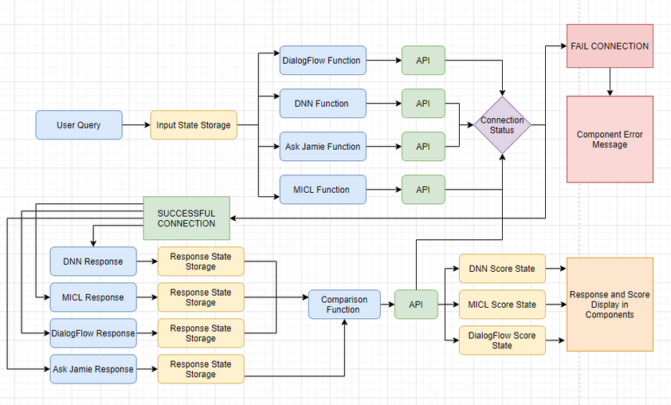
FEATURES
30
Text Input Handling
Text input are stored in a state and passed to respective respective Chat bot services
Use of JavaScript promises to ensure asynchronous execution of Chat bot request
Notes:
The first feature would be the text input. Text input is the single point of entry for any FAQ intentions, this includes the handling of speech transcriptions from real time audio inputs. Hence text input handling must be able to store input changes and final transcribed strings before sending them out to the respective chatbot services.

Slide 31
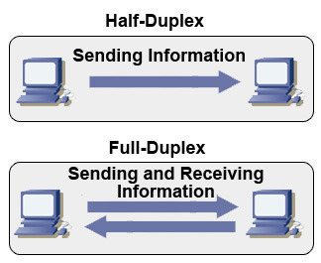
FEATURES
31
Speech Input Handling
Audio streaming between client and server
Web sockets to establish full duplex communication channel
Persistent communication over single TCP connection
Half Duplex vs Full Duplex Diagram adapted from
https://www.ccna-study.com/2019/05/half-duplex-and-full-duplex.html
Notes:
Speech input feature allows real time audio streaming and transcription between the client and server. Simulating a speech interaction with the Chatbot through voice recognition technology.
Unlike the half duplex client server communication, live streaming of audio requires a full duplex communication so that transcribed audio can be received while a user continues to speak, hence this requires persistent communication between the client server to achieve a real time speech interaction.

Slide 32

FEATURES
32
Transcription Service
AUDIO TO
BLOB
Transcribed Text
AISG Speech to Text API
Node Server forwards socket link to AISG
BLOB audio data streamed and sent to STT API for decoding and transcription
Transcribed Text Object
BLOB
AI Singapore Logo adapted from
https://www.aisingapore.org/
Notes:
Speech input process would require connection to a audio transcription engine before passing the transcribed text as a text input to the Chabot services. AISG Singapore will be providing the speech transcription API endpoint for the project.
A basic transcription works with the establishment of a web socket connection between the react client, Node server and the ASR endpoint as shown in the figure. Audio data is sent as blob data or raw data to the node server and forwarded to the ASR endpoint for audio reconstruction and transcription.
The transcribed output will be returned as text object which will be parsed and sent back to the react client as transcribed text.

Slide 33
FEATURES
33
Response Comparison
DIALOGFLOW
Chat bot response comparisons with Ask Jamie Chatbot benchmark
Client keeps states of benchmark response and test chatbot response pair
Sends response pairs to comparator API served by Flask
ASK JAMIE
DNN MODEL
MICL LABS
Notes:
The next feature will be the response comparison, the objective of this feature is to be able to compute a similarity value between a chatbot and the ask Jamie chatbot.
This feature is implemented to test a chatbot's FAQ matching capabilities by testing it against a production grade chatbot service.
For every chatbot response received, the framework will pair each response of the chatbot with the response of ask Jamie before sending them to the comparator API hosted on Flask.

Slide 34
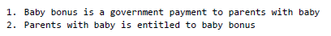
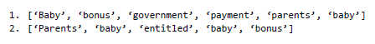
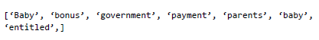
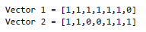
FEATURES
34
Response Pair
Sentence to Vector
2. Tokenization
Tokenization of each response
Stop word removal to keep keywords
Union of tokens to create a unique vocabulary list
Bag of words vector for each sentence
3. Union of Token
4. Bow vector
Notes:
On the flask side, the comparator API goes through 2 main steps sentence vectorizing and cosine similarity.
In the vectorizing step, the responses goes through tokenization where the sentences are broken down to its individual words, stop words are removed to keep keywords and remove possibilities of it affecting the similarity value.
Word tokens are further stemmed as well to make sure that plural forms of the same word are considered when matching.
word tokens are then used to create a unique word lists for the creation of each response vector. This vectors are created by setting 1s to the present words of the response tokens that exists in the word lists.

Slide 35
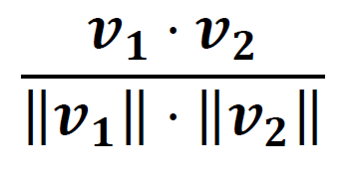
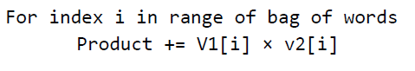
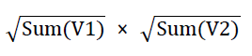
FEATURES
35
Cosine Similarity
Quantification of similarity of sequences by treating them as vectors
Apply cosine similarity on obtained vector pairs to obtain similarity
0 represents mismatch, 1 represents complete match
Notes:
Once the 2 sets of vectors are computed, cosine similarity formula is applied between the vectors as shown in the figure. where the product of vectors are divided with the product of the norm of each vector. This would return a value from 0 to 1 with 1 representing an exact match and 0 representing a complete mismatch.
This value will then be passed back to the client side for display in the framework.

Slide 36
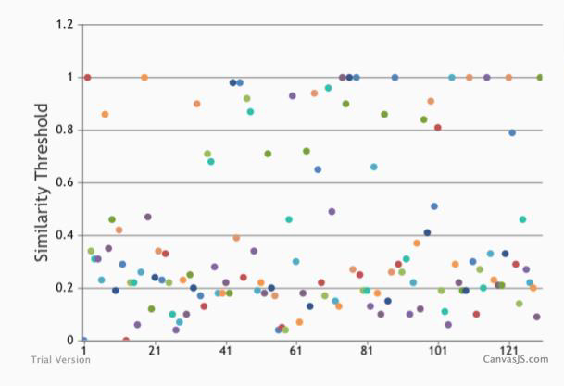
FEATURES
36
Performance Analysis
Graphical analysis of Chat bot response accuracy against benchmark
Mass query sending for large scale visualization
Notes:
The final feature is a overall performance view of the application. This is displayed through a scatter graph report of response accuracies given a batch of test intentions.

Slide 37
FEATURES
37
INPUT 1
INPUT 2
INPUT 3
.
.
Bulk Data Processing
Mass sending of inputs to chatbot and Ask Jamie service
Collection of response pairs for posting to comparison service
Asynchronous solution implemented to queue API call events
Jamie API
API Dialogflow
RESPONSE 1
RESPONSE 2
COMPARISON
Accuracy Array
Notes:
Each intention is loaded into a selected chatbot service and ask Jamie, the response pairs of all intentions will be collated into an array and sent to the comparison API. The result of the comparison will be collated and displayed on the graph.

Slide 38

38
DEMO
Notes:
To conclude properly conclude this presentation, here is a short demonstration of the chatbot framework.

Slide 39
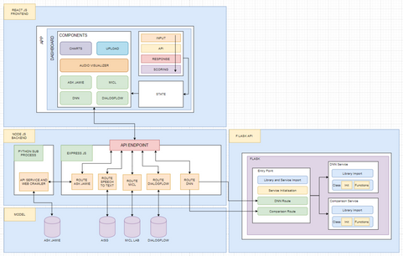
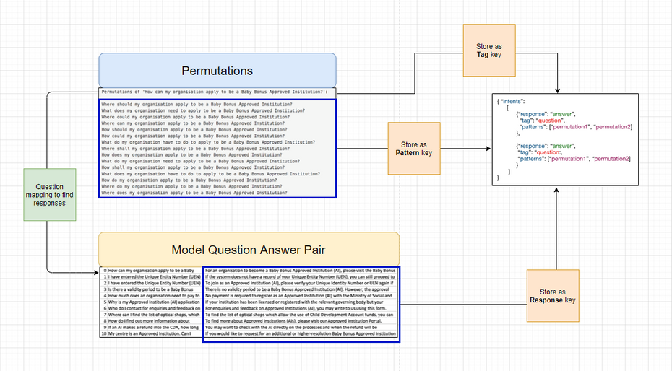
CONTRIBUTIONS
39
Web Chatbot Framework
Text and Speech Based input
Response Comparison Service
Performance Visualization
Dialogflow Integration
Training Data
Pre-processing
Notes:
To summarize the following figures are contributions made for this final year project. A complete build up of the web chatbot framework, development of multiple input methods, a response comparison service, performance visualization, integration of open source chatbot platforms and lastly pre-processing algorithms that are hopefully useful in future training of QA Models.
This Chatbot framework hopes to support upcoming Chatbot and speech transcription projects by providing a platform to upload their work for performance comparisons against other developers.

Slide 40
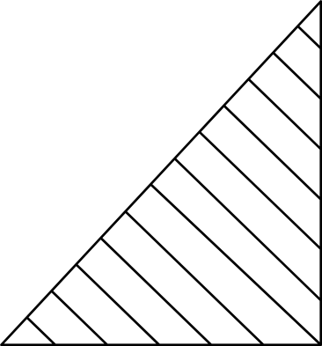
40
MODULAR INTEGRATION OF CHATBOT SERVICE
FUTURE
IMPLEMENTATIONS
Notes:
Some recommendations on the improvement of this framework is to include a add on form option for adding of new chatbot configurations directly from the framework. Since the current implementation only allows code level integrations, an interface for chatbot integration would improve overall usability of the application.

Slide 41
41
DYNAMIC DATABASE STORE FOR CHATBOT RE-TRAINING
FUTURE
IMPLEMENTATIONS
Notes:
The final recommendation for this framework would be a database store of past queries and appropriate answers. This can be used to help developers with re-enforced training of their chatbots.

Slide 42
END OF PRESENTATION
Notes:
With that, this brings me to the end of the presentation. Thank you.

